Slide 1
Noise can be resource: Stochastic Resonance (Section 2e)
Udayan Ganguly
Aug 16, 2018
A good reference – “Stochastic Electronics: A Neuro-Inspired Design Paradigm for Integrated Circuit“
Matlab codes are given in https://drive.google.com/open?id=14Ecx1azTO2olEki2TwE9I3fVOtF-S4Z5

Slide 2
Levels of engineering response to Noise
High- precision ➔ noise intolerant
High-precision with feedback ➔ noise tolerant
Noise-amplified sensors/detectors
Noise enabled computing

Slide 3
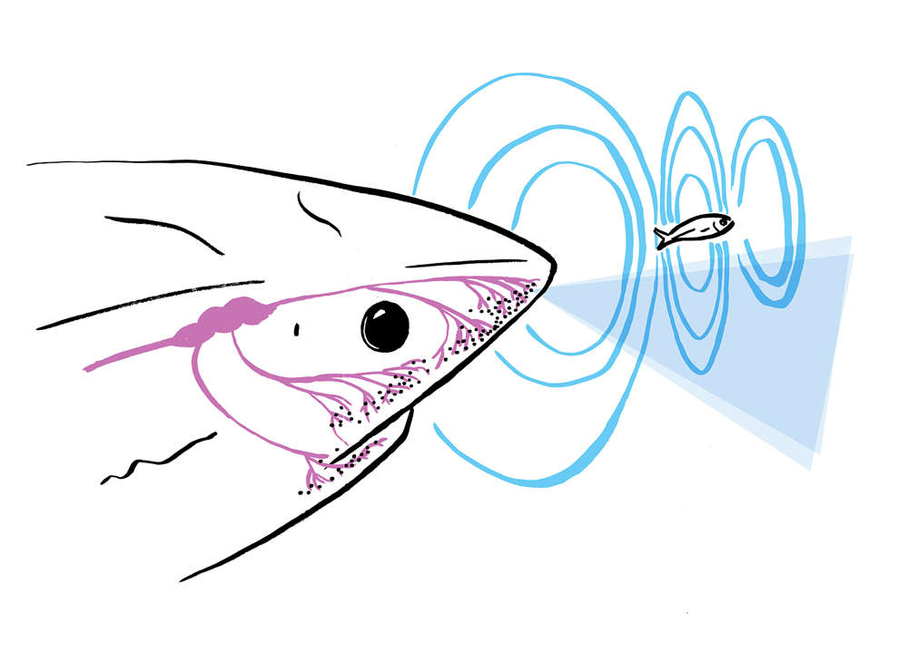
Sharks, skates and Stingray
Sharks, skates, and rays receive electrical information about the positions of their prey, the drift of ocean currents, and their magnetic compass headings.
Voltage gradients of only 5 nanovolts per centimeter would elicit either behavior.
https://science.sciencemag.org/content/218/4575/916
https://en.wikipedia.org/wiki/Electroreception
Notes:
At sea, dogfish and blue sharks were observed to execute apparent feeding responses to dipole electric fields designed to mimic prey. In training experiments, stingrays showed the ability to orient relative to uniform electric fields similar to those produced by ocean currents.

Slide 4
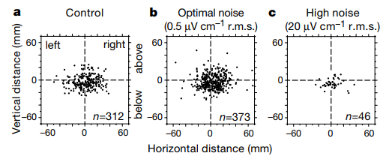
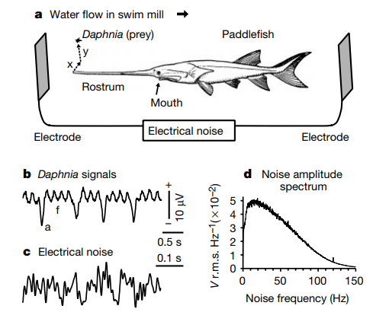
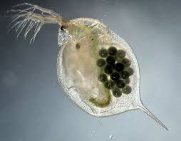
Stochastic resonance in paddle fish
Adding optimal noise, maximized strike zone;
Indicating larger sensing space.
https://www.nature.com/articles/46279.pdf
Notes:
Excerpt:
Paddlefish feed on zooplankton, especially Daphnia , in North American rivers where muddy turbidity limits vision. Instead, paddlefish use an electrosensory antenna to locate plankton.
The long flattened `rostrum' in front of the mouth (Fig. 1a) is covered with tens of thousands of passive electroreceptors11,15 similar to the ampullae of Lorenzini of sharks and rays16,17. The electroreceptors respond best to low frequency (0.5-20 Hz) external fields, as produced by Daphnia prey. About 95% of Daphnia are taken at radial distances less than 40 mm. Plankton further from the rostrum are less likely to be detected, owing to the dipole-like electric field from Daphnia, which decreases approximately as the inverse cube of distance. Other sensory modalities, including vision and lateral line mechanosense, are not necessary for prey capture.
Our hypothesis is that when a random electric field of optimal amplitude is applied to the environment in which a paddlefish is swimming and feeding, more distant plankton can be located and captured, compared with zero-field controls, owing to the dynamical process of stochastic resonance.
Our hypothesis predicts that the spatial distribution of strike locations should become more spread out (show increased scatter or variance) when an optimal level of noise is presented. The only variable in our experiments was the selected amplitude (0.05-50 mV cm-1 r.m.s.) of a randomly varying electrical stimulus passed through the water in the swim mill, between plate electrodes in front of the ®sh and behind it (Fig. 1a). Noise of different amplitudes strongly affected the spatial distribution of strike locations. The scatter of the feeding strike locations was increased during presentation of 0.2±1mV cm-1 noise, and was maximally increased during 0.5 mV cm-1 noise (Fig. 2b), compared with zero-®eld controls (Fig. 2a). This amplitude, 0.5 mV cm-1 r.m.s., was therefore de®ned to be the optimal noise amplitude. Higher levels of noise caused the distribution of strike locations to become compressed (show reduced scatter); that is, only nearby Daphnia elicited strikes

Slide 5
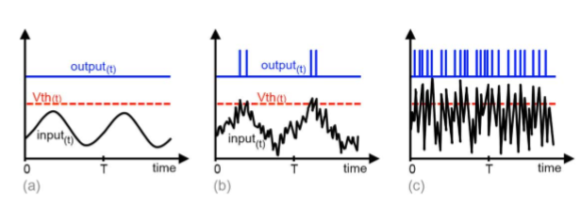
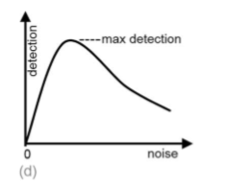
The extent of noise must carefully added for best performance
How will you write a program to simulate this test?

Slide 6
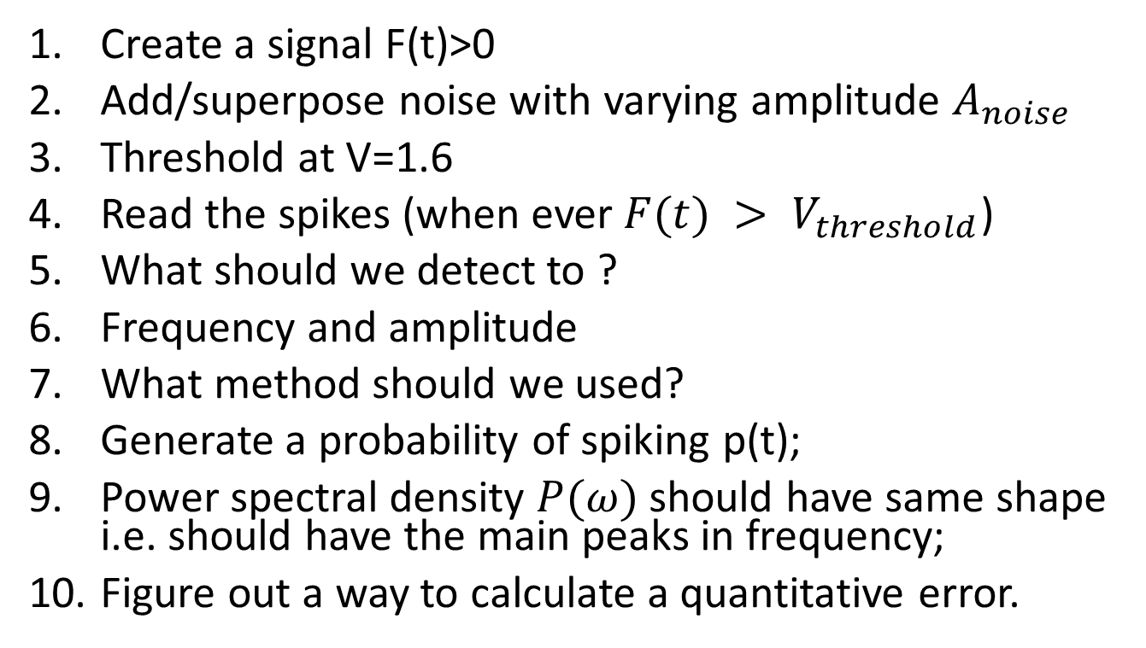
How will you replicate the experiment?
Create a signal F(t)>0
Add/superpose noise with varying amplitude $A_{noise}$
Threshold at V=1.6
Read the spikes (when ever $F(t) > V_{threshold}$)
What should we detect to ?
Frequency and amplitude
What method should we used?
Generate a probability of spiking p(t);
Power spectral density $P(ω)$ should have same shape i.e. should have the main peaks in frequency;
Figure out a way to calculate a quantitative error.

Slide 7
What happens if the noise is not exact?
Sensor Threshold = 1.6
Increasing Noise Amplitude

Slide 8
Stochastic Resonance
Reconstructed signal from single neurons is poor and noisy
Increasing Noise Amplitude

Slide 9
The effect of many Neurons (=500)
Number of “Spikes” in train for 500 neurons generates a smooth function
Autocorrelation Function of the spike train sum of many neurons (left)
Weak output
Weak signal
Increasing Noise Amplitude
Good ouput
Good signal
No signal
No signal

Slide 10
Power-spectral Density
Primary PSD peak of signal (in frequency) and reconstructed signal match well
I chose to calculate error in PSD; It shows a minima which is qualitatively consistent
In the next slide, we see the results near the minimum error point

Slide 11
Near Minimum Error – signal and reconstructed signal are close
Many neuron (=500) average signal
Smooth Autocorrelation Function replicates the signal i.e. (1-x)
ACF shape does not match signal

Slide 12
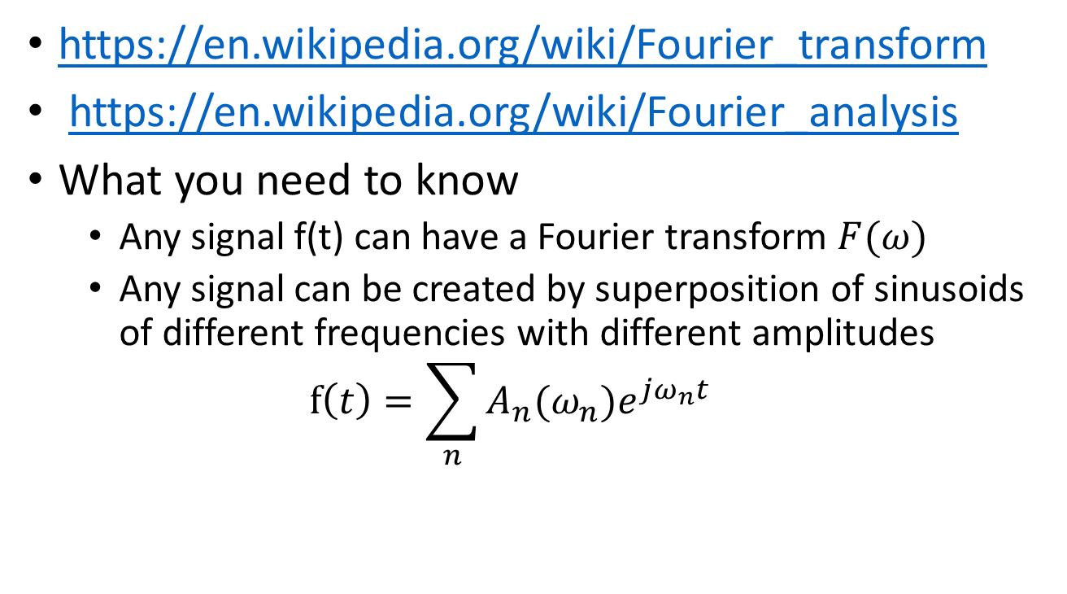
Basics: Fourier Analysis
https://en.wikipedia.org/wiki/Fourier_transform
https://en.wikipedia.org/wiki/Fourier_analysis
What you need to know
Any signal f(t) can have a Fourier transform $F(ω)$
Any signal can be created by superposition of sinusoids of different frequencies with different amplitudes
$$f\left(t\right)=\sum_{n}{A_{n}(ω_{n})e^{jω_{n}t}}$$

Slide 13
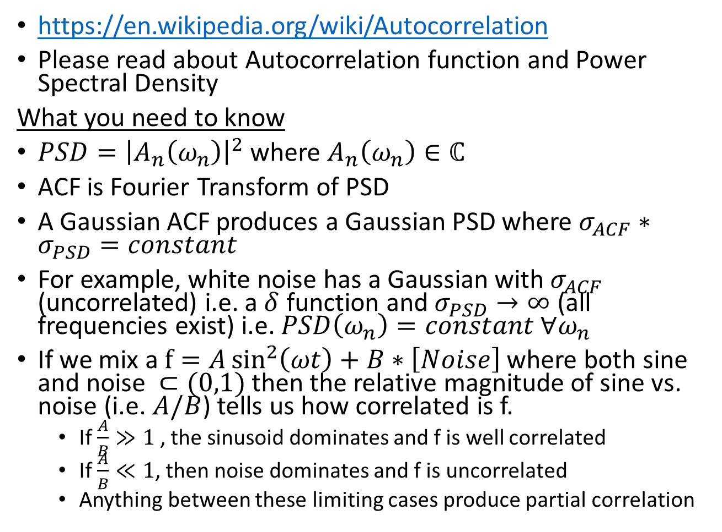
Power Spectral Density (PSD) & Autocorrelation Function (ACF)
https://en.wikipedia.org/wiki/Autocorrelation
Please read about Autocorrelation function and Power Spectral Density
What you need to know
$PSD={\left|A_{n}\left(ω_{n}\right)\right|}^{2}$ where $A_{n}\left(ω_{n}\right)∈ℂ$
ACF is Fourier Transform of PSD
A Gaussian ACF produces a Gaussian PSD where $σ_{ACF}∗σ_{PSD}=constant$
For example, white noise has a Gaussian with $σ_{ACF}$ (uncorrelated) i.e. a $δ$ function and $σ_{PSD}→∞$ (all frequencies exist) i.e. $PSD\left(ω_{n}\right)=constant ∀ω_{n}$
If we mix a $f=A\sin^{2}\left(ωt\right)+B∗\left[Noise\right]$ where both sine and noise $⊂(0,1)$then the relative magnitude of sine vs. noise (i.e. $A/B$) tells us how correlated is f.
If $\frac{A}{B}≫1$, the sinusoid dominates and f is well correlated
If $\frac{A}{B}≪1$, then noise dominates and f is uncorrelated
Anything between these limiting cases produce partial correlation

Slide 14
Questions
https://drive.google.com/open?id=14Ecx1azTO2olEki2TwE9I3fVOtF-S4Z5
Run the MATLAB code (given above).
Write down the flow chart of the program
Does the conclusion qualitatively change with the type of noise (uniform vs Gaussian). Please check in the code
What is the difference between using a single neuron vs. many neurons for the spikes vs time? How does adding sensor neurons help? A more detailed question, how does it relate to ACF noise?

Slide 15
Everything after this is not covered in Quiz 1

Slide 16

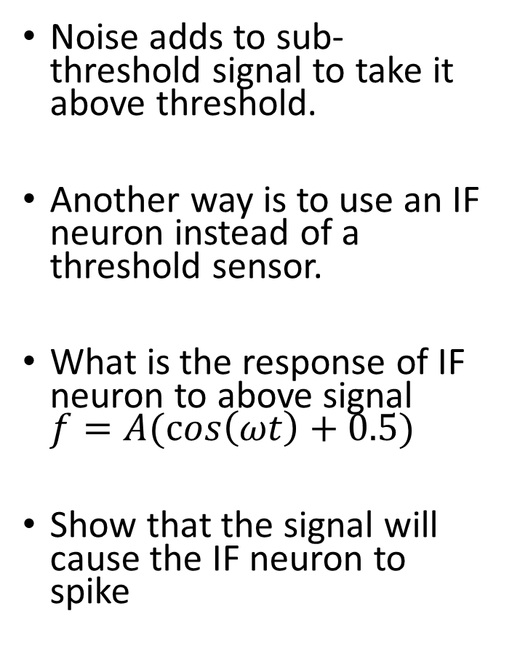



Can we avoid noise tuning requirement?
$$I_{in}$$
Fast signal
Noise adds to sub-threshold signal to take it above threshold.
Another way is to use an IF neuron instead of a threshold sensor.
What is the response of IF neuron to above signal $f=A(\cos\left(ωt\right)+0.5)$
Show that the signal will cause the IF neuron to spike
$$time$$
Integrate and Figure Neuron
$$V_{m}$$
Slow neuron
$$time$$
This is amplification?! More like adding an increasing offset

Slide 17
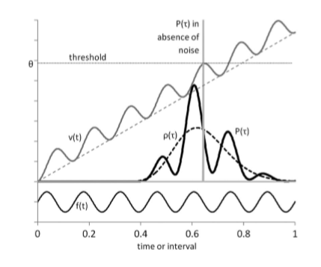
Integration given amplification

Slide 18
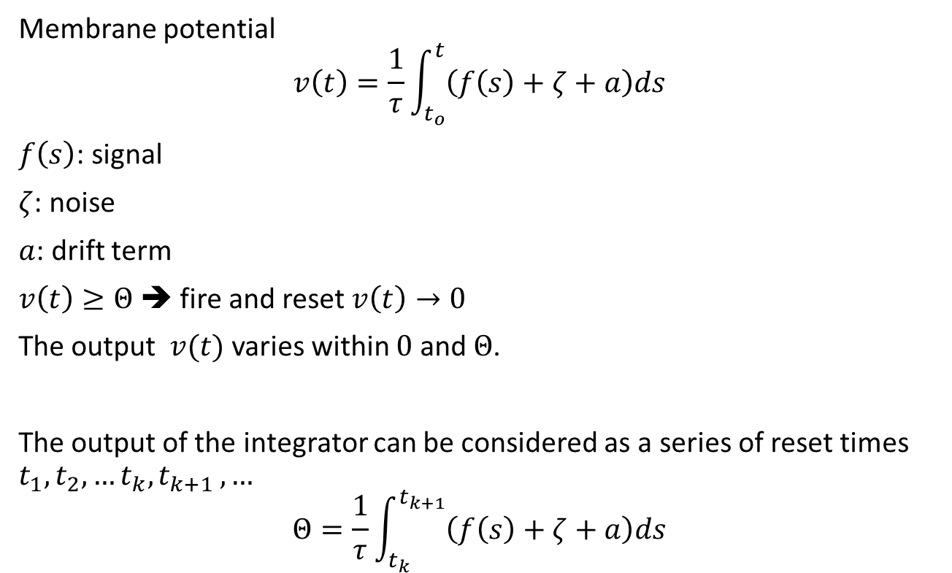
Can we avoid noise tuning requirement?
Membrane potential
$$v\left(t\right)=\frac{1}{τ}\int_{t_{o}}^{t}{\left(f\left(s\right)+ζ+a\right)ds}$$
$f\left(s\right)$: signal
$ζ$: noise
$a$: drift term
$v\left(t\right)≥Θ$ ➔ fire and reset $v\left(t\right)→0$
The output $v(t)$ varies within $0$ and $Θ$.
The output of the integrator can be considered as a series of reset times $t_{1}, t_{2},…t_{k}, t_{k+1 }, …$
$$Θ=\frac{1}{τ}\int_{t_{k}}^{t_{k+1}}{\left(f\left(s\right)+ζ+a\right)ds}$$

Slide 19
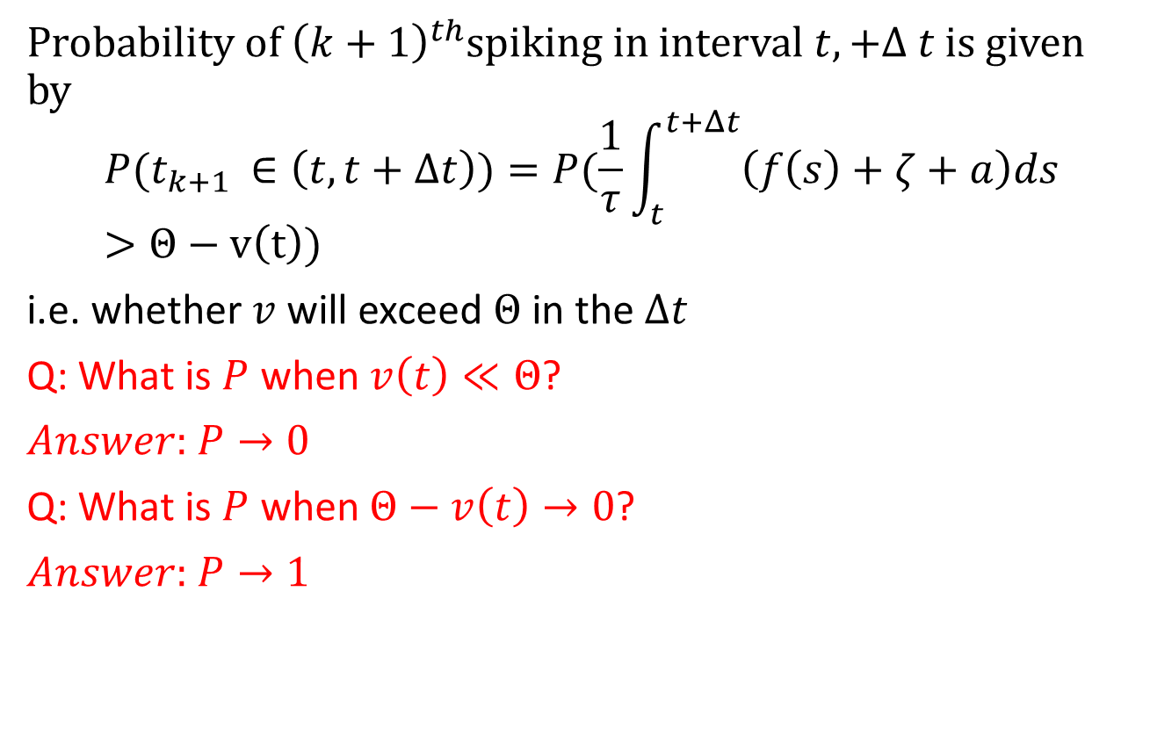
Computing Probability of spike
Probability of ${\left(k+1\right)}^{th}$spiking in interval $t,+Δ t$ is given by
$$P(t_{k+1 }∈\left(t,t+Δt\right))=P(\frac{1}{τ}\int_{t}^{t+Δt}{\left(f\left(s\right)+ζ+a\right)ds}>Θ−v\left(t\right))$$
i.e. whether $v$ will exceed $Θ$ in the $Δt$
Q: What is $P$ when $v\left(t\right)≪Θ$?
$Answer:$ $P→0$
Q: What is $P$ when$Θ−v\left(t\right)→0$?
$Answer:$ $P→1$

Slide 20
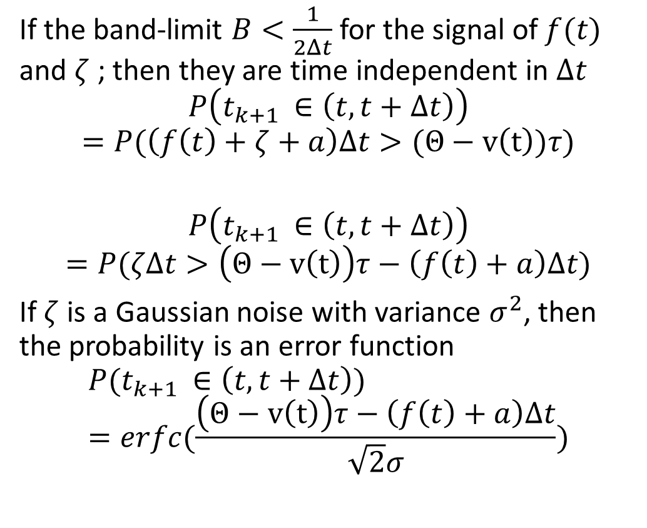

Converting stochastic integral to erfc
If the band-limit $B<\frac{1}{2Δt}$ for the signal of $f(t)$ and $ζ$ ; then they are time independent in $Δt$
$$P\left(t_{k+1 }∈\left(t,t+Δt\right)\right)$$
$$=P(\left(f\left(t\right)+ζ+a\right)Δt>(Θ−v\left(t\right))τ)$$
$$P\left(t_{k+1 }∈\left(t,t+Δt\right)\right)$$
$$=P(ζΔt>\left(Θ−v\left(t\right)\right)τ−\left(f\left(t\right)+a\right)Δt)$$
If $ζ$ is a Gaussian noise with variance $σ^{2}$, then the probability is an error function
$$P(t_{k+1 }∈\left(t,t+Δt\right))=erfc(\frac{\left(Θ−v\left(t\right)\right)τ−\left(f\left(t\right)+a\right)Δt}{\sqrt{2}σ})$$
P(t)
t
$$P\left(x<x_{o}\right)$$
erfc
t
This means that at some $t→T_{neuron}$; the $P→1$ spiking will occur.

Slide 21
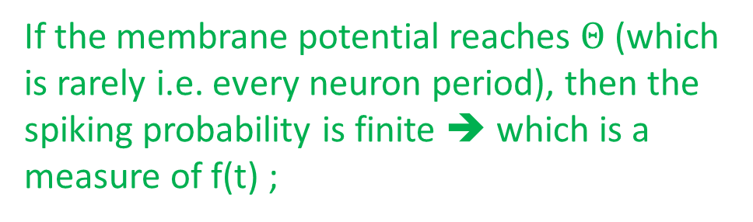

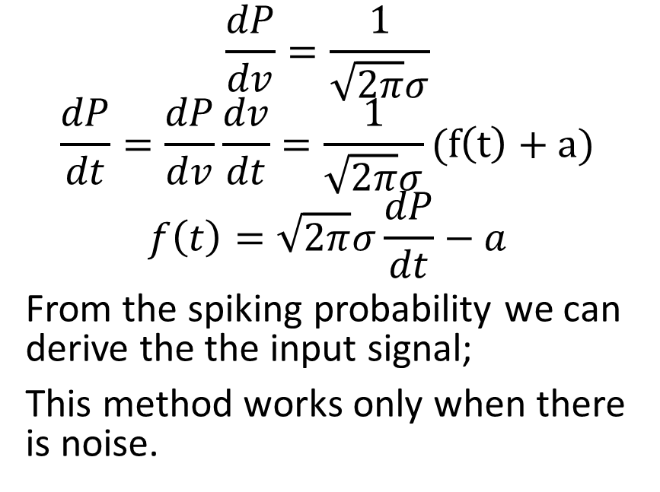



Trick: Simplifying erfc to linear
P(t)
$$\frac{dP}{dv}=\frac{1}{\sqrt{2π}σ}$$
$$\frac{dP}{dt}=\frac{dP}{dv}\frac{dv}{dt}=\frac{1}{\sqrt{2π}σ}(f\left(t\right)+a)$$
$$f\left(t\right)=\sqrt{2π}σ\frac{dP}{dt}−a$$
From the spiking probability we can derive the the input signal;
This method works only when there is noise.
$$2σ$$
t
$$P\left(x<x_{o}\right)$$
Lin approx
erfc
t
Slow noise-free neuron
$$time$$
If the membrane potential reaches $Θ$ (which is rarely i.e. every neuron period), then the spiking probability is finite ➔ which is a measure of f(t) ;
Slow noisy neuron
$$time$$

Slide 22

How do we sample more often uniformly?
What is the source of this noise?
External medium like paddlefish?
Or
This is neuronal noise?
$$time$$
How can we mitigate the rareness of spiking?
Many neurons which are all starting phase matched
or
Many neurons which have random starting phase .e. decoherent

Slide 23
Effect of de-coherence & slow neuron vs fast signal
Design a IF based sensor system.
What is effect of number of neurons?
How do we chose period of neuron vs. signal?
What is the period of the neuron vs the signal?

Slide 24
Even low noise causes detection
Increasing Noise Amplitude

Slide 25
Noise dependence reduced
Stochastic Resonance
IF based detection with decoherence
Increasing Noise Amplitude

Slide 26
Summary
In special cases, noise is essential for sensory detection
Case 1: External noise is needed for Stochastic Resonance
Case 2:
De-coherence and IF based threshold will enable detection of small signals at fixed external noise;
Fast signal are detected by slow neurons

